Slide 1
OpenCount Improved support for Machine-Assisted Ballot-Level Audits
Eric Kim, Nicholas Carlini, Andrew Chang, George Yiu,
Kai Wang†, David Wagner
University of California, Berkeley
†University of California, San Diego
EVT/WOTE 2013. Washington DC. 8/13/2013.

Slide 2
Talk Overview
Motivation
How can OpenCount help the audit process?
Challenges
Important: Accuracy and scalability
Pipeline Overview
Election Experiences
Questions
Notes:
Today, we’ll be looking at the OpenCount project, which is software to tabulate elections.
How can OpenCount help you?
Some details on the system
Our experience using OpenCount on several election datasets

Slide 3
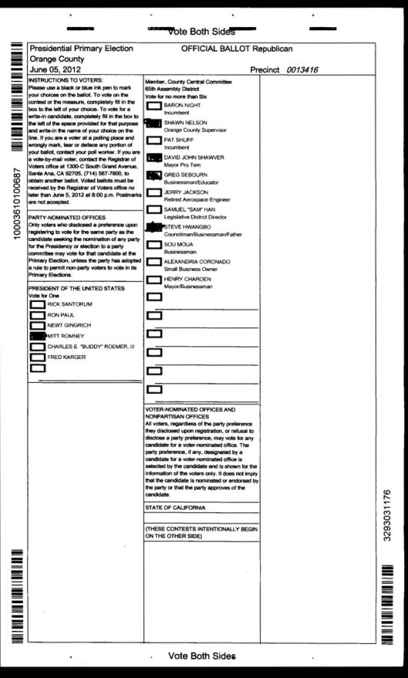
What is OpenCount?
Software that tabulates elections
Generates ballot-level cast vote records
CVR 00001
President of the United States
Mitt Romney
Member, County Central Com.
Shawn Nelson
David John Shawver
Greg Sebourn
Steve Hwangbo

Slide 4
Motivation
Want to perform a post-election audit
Statistical ballot-level audit
Risk-limiting audit
Typically only have to examine tens to hundreds of ballots (depends on margin)
More efficient than alternative
CA: Each county hand-counts all ballots from1% of precincts
Notes:
So, what role does a tool like OpenCount play?
Say that you are an election official, and you’d like to perform a post-election audit.
Such as, a ballot-level risk-limiting audit.

Slide 5
Motivation (cont.)
Ballot-level audits require: access to the voting system’s interpretation of each ballot
Cast Vote Record (CVR) for each ballot
Electronic record of the cast votes
Notes:
In order to perform a ballot-level audit, you need to be able to do the following:
Given a voter-marked ballot, compare the official voting system’s interpretation to what’s actually on the ballot.
We call the official voting system’s interpretation of a ballot a “Cast Vote Record” (or CVR).

Slide 6

Motivation (cont.)
Cast Vote Record (CVR)
CVR 00001
President of the United States
Mitt Romney
Member, County Central Com.
Shawn Nelson
David John Shawver
Greg Sebourn
Steve Hwangbo
?
=

Slide 7
Motivation (cont. )
Problem: current deployed voting systems do not output CVRs for each ballot
Only output election totals
Notes:
The complication is: most deployed voting systems do not output ballot-level CVRs.
They were only designed to output cumulative election totals.

Slide 8
Motivation (cont. )
Can’t “upgrade” existing systems
Most vendors are focusing on next-gen systems
EAC certification process (U.S. Election Assistance Commission) would make upgrade expensive
Notes:
To make matters worse, for a variety of reasons we can’t expect to upgrade already-deployed systems to add this functionality.
Vendors are more interested in developing new systems.
Updating deployed systems may require recertifying through the Election Assurance Commission, which is time consuming.
Finally, some systems simply do not have the capabilities to output ballot-level CVRs.

Slide 9

Motivation (cont. )
What is one to do?
If you can’t improve it, rebuild it!
Notes:
So, what can we do?
If we can’t upgrade the voting systems, then we’ll just build it ourselves.
In other words, build new system just to support ballot-level audits.

Slide 10
OpenCount
Tabulates elections
Input: Scanned ballot images
Output: Cast Vote Records, election totals.
Built specifically with ballot-level audits in mind
Open-source software (free!)
http://code.google.com/p/opencount/
Notes:
OpenCount is a tool that implements the full ballot interpretation pipeline.
It takes the scanned ballot images as input, and outputs ballot-level CVRs, as well as cumulative election totals.
Also, it’s an open-source project, and you can check it out at the following URL.

Slide 11
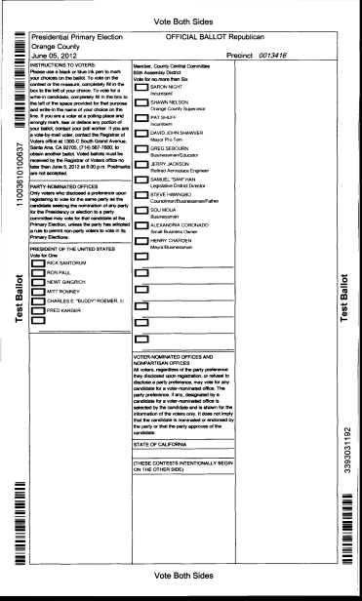
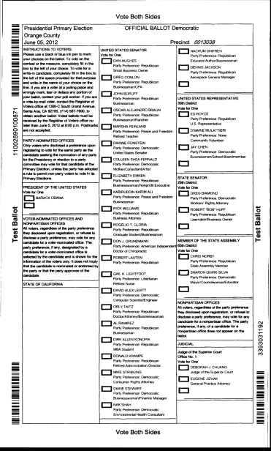
First Attempt: Blank Ballots
Collect one blank ballot from each ballot style
Blank Ballot: Unmarked ballot
Style A
Style B
Notes:
OpenCount is a tool that implements the full ballot interpretation pipeline.
It takes the scanned ballot images as input, and outputs ballot-level CVRs, as well as cumulative election totals.
Also, it’s an open-source project, and you can check it out at the following URL.

Slide 12
With Blank Ballots… (1/6)
Style A
Style B
Notes:
OpenCount is a tool that implements the full ballot interpretation pipeline.
It takes the scanned ballot images as input, and outputs ballot-level CVRs, as well as cumulative election totals.
Also, it’s an open-source project, and you can check it out at the following URL.

Slide 13
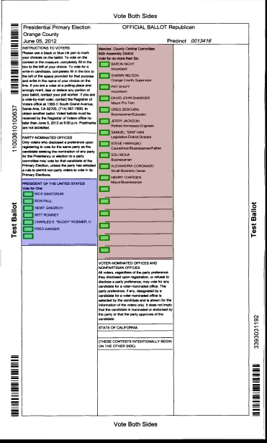
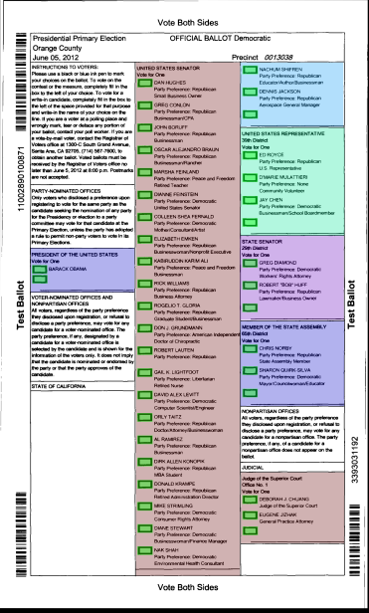
With Blank Ballots… (2/6)
Style A
Style B

Slide 14

With Blank Ballots… (3/6)
Style A
Style B

Slide 15
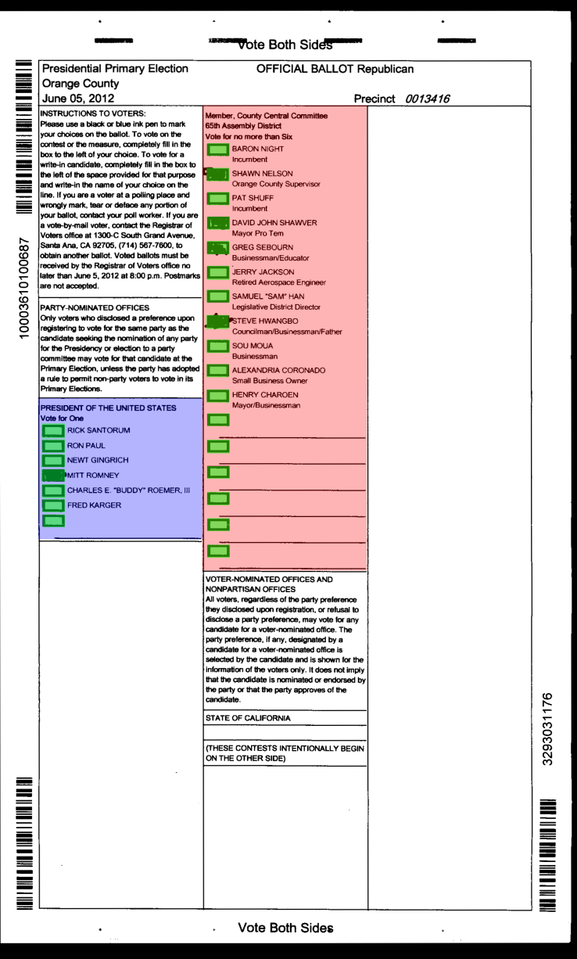
With Blank Ballots… (4/6)
Style A
Style B

Slide 16
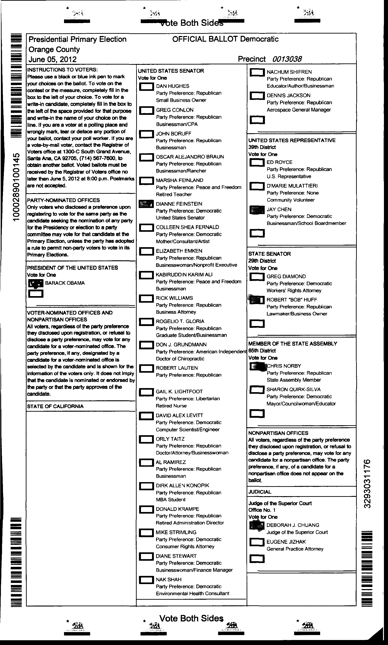
With Blank Ballots… (5/6)
Style A
Style B

Slide 17
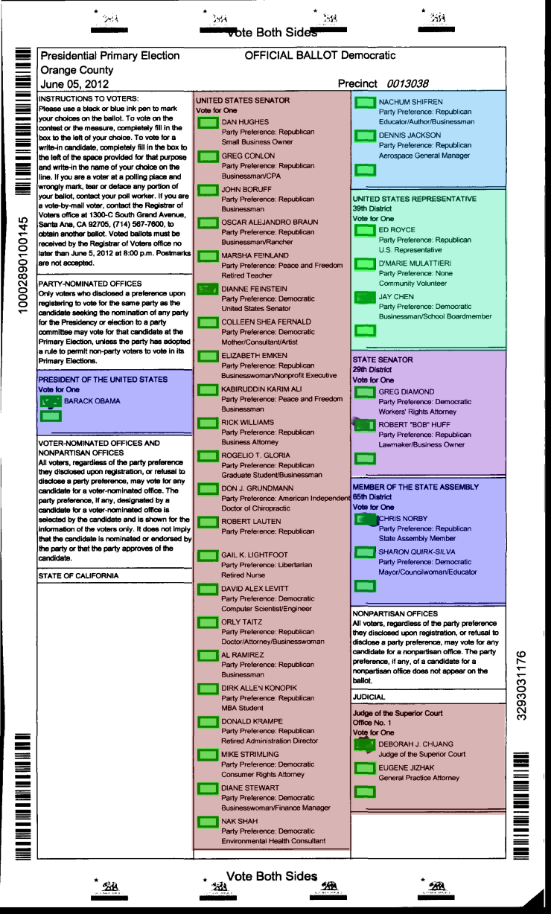
With Blank Ballots… (6/6)
Style A
Style B

Slide 18
Previous Work
EVT/WOTE 2012 (Bellevue, Washington)
First introduction of the OpenCount (2012) system
“Operator-Assisted Tabulation of Optical Scan Ballots”. Kai Wang, Eric Kim, Nicholas Carlini, Ivan Motyashov, Daniel Nguyen, David Wagner.
Required collecting all blank ballots
Notes:
As I mentioned before, the OpenCount system was originally introduced last year at EVT 2012, in Bellevue, Washington.
This was work done with Kai Wang, Nicholas Carlini, Ivan Motyashov, Daniel Nguyen, and David Wagner.
There were good things about this system, but there were a few shortcomings present that we discovered.

Slide 19
Previous Work (cont.)
Problem: Did not scale to large elections
Collecting blank ballots is a huge burden for election officials
Blocked some counties from participating
Overall, too much required effort
Notes:
First, the 2012 system required a set of “blank” ballots to function.
What the election officials had to do was:
a.) Collect and scan one unmarked ballot for every possible ballot style/layout.
This could be challenging for officials to collect, and introduces a significant barrier of entry.
Second, the 2012 system did not have a good way to output precinct-level results.
Finally, the 2012 system simply did not scale to large, complex elections.
In particular, the amount of required human effort grew too large for complex elections.
These were all limitations that we encountered while processing election data sets sent to us by various counties from California and Florida.

Slide 20
A Second Attempt
New approach: No blank ballots
Notes:
In this work, we reworked parts of the system to produce a new system that addresses each of the previous weaknesses.
The three major improvements are:
a.) No need for blank ballots
b.) Stream-lined process for outputting precinct-level results
c.) Reduce required human effort
The bottom-line result is: we can now process larger, more complex elections than ever before.

Slide 21

How can we do this?
Notes:
To get a sense of the nature of the problem, let’s take a step back and ask: why is implementing a ballot interpretation pipeline difficult?
In other words, if you and I decided to build a brand-new system, what should we watch out for?

Slide 22
No Blank Ballots
Style A
Style B
Notes:
OpenCount is a tool that implements the full ballot interpretation pipeline.
It takes the scanned ballot images as input, and outputs ballot-level CVRs, as well as cumulative election totals.
Also, it’s an open-source project, and you can check it out at the following URL.

Slide 23
No Blank Ballots
How to find:
Voting Targets?
Contests?

Slide 24
OpenCount Pipeline
Overview of system
Election experiences
California risk-limiting audit pilot program
Notes:
Now, I’ll go over a brief overview of the OpenCount system, where I’ll go over how we addressed some of these challenges.
Then, we’ll talk about how we actually were able to use OpenCount to support a few pilot audits in several CA counties.

Slide 25
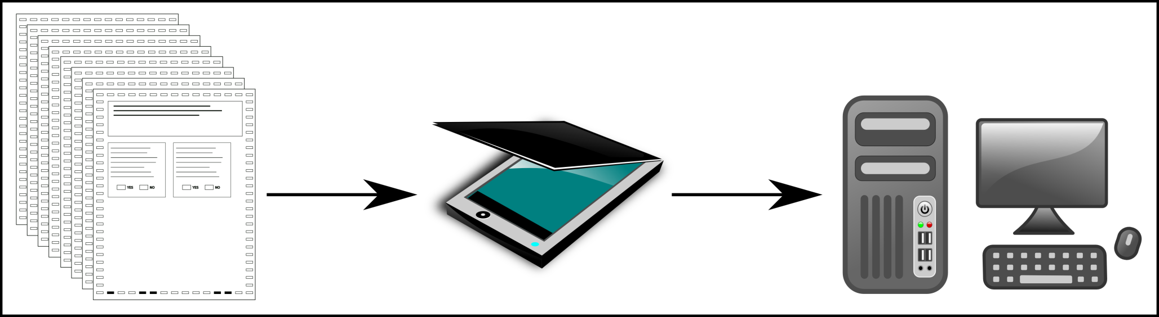
Scan Ballots (1/6)
Use any commercial, off-the-shelf scanner
Notes:
First, you scan the ballots.
You can use any commercial, off-the-shelf scanner.

Slide 26
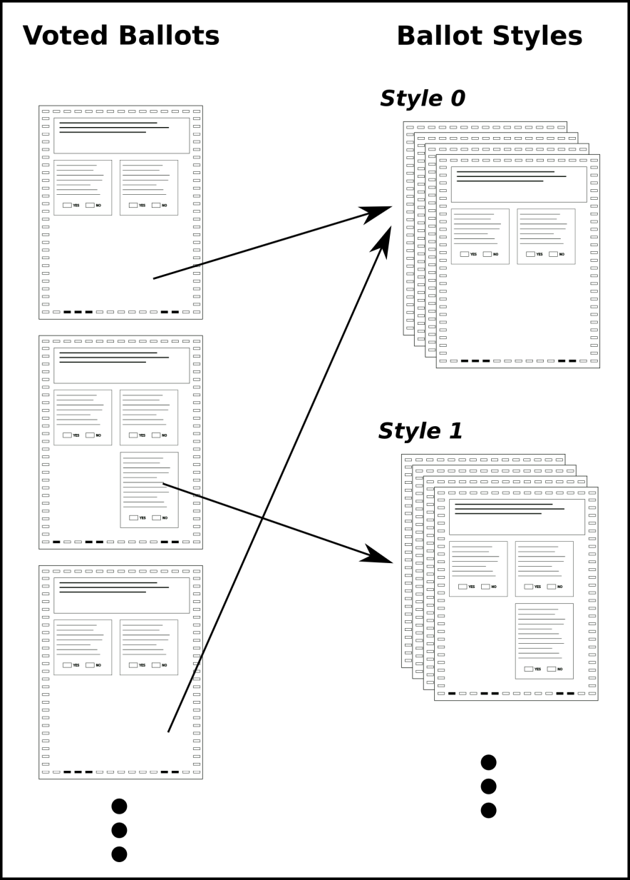
Ballot Grouping (2/6)
Notes:
- Makes annotation easier (only annotate one ballot from each group)
- Number of ballot styles << number of voted ballots

Slide 27
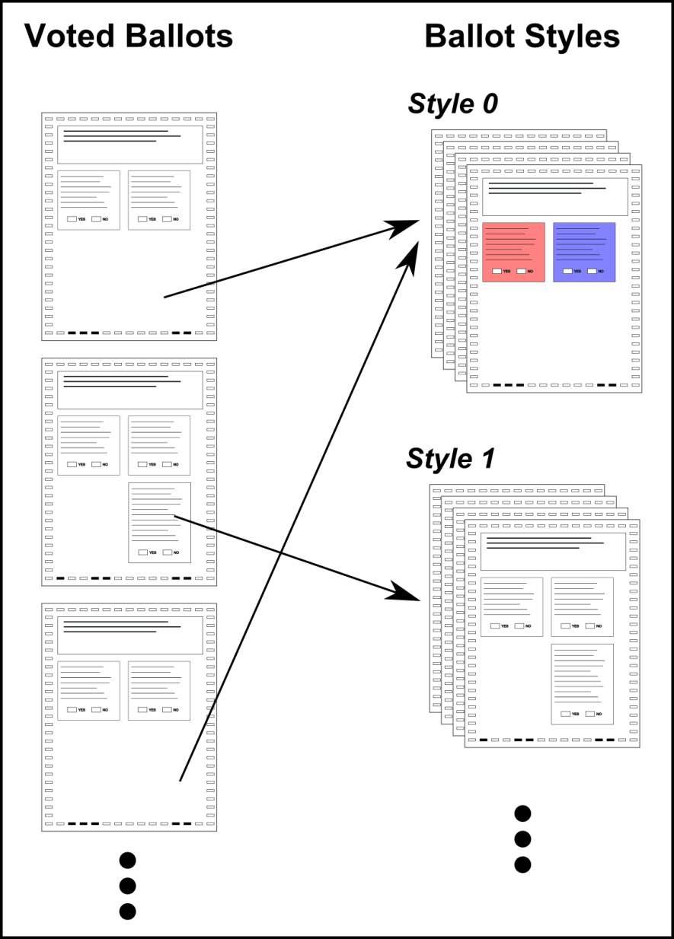
Ballot Grouping (2/6)
Notes:
- Makes annotation easier (only annotate one ballot from each group)
- Number of ballot styles << number of voted ballots

Slide 28
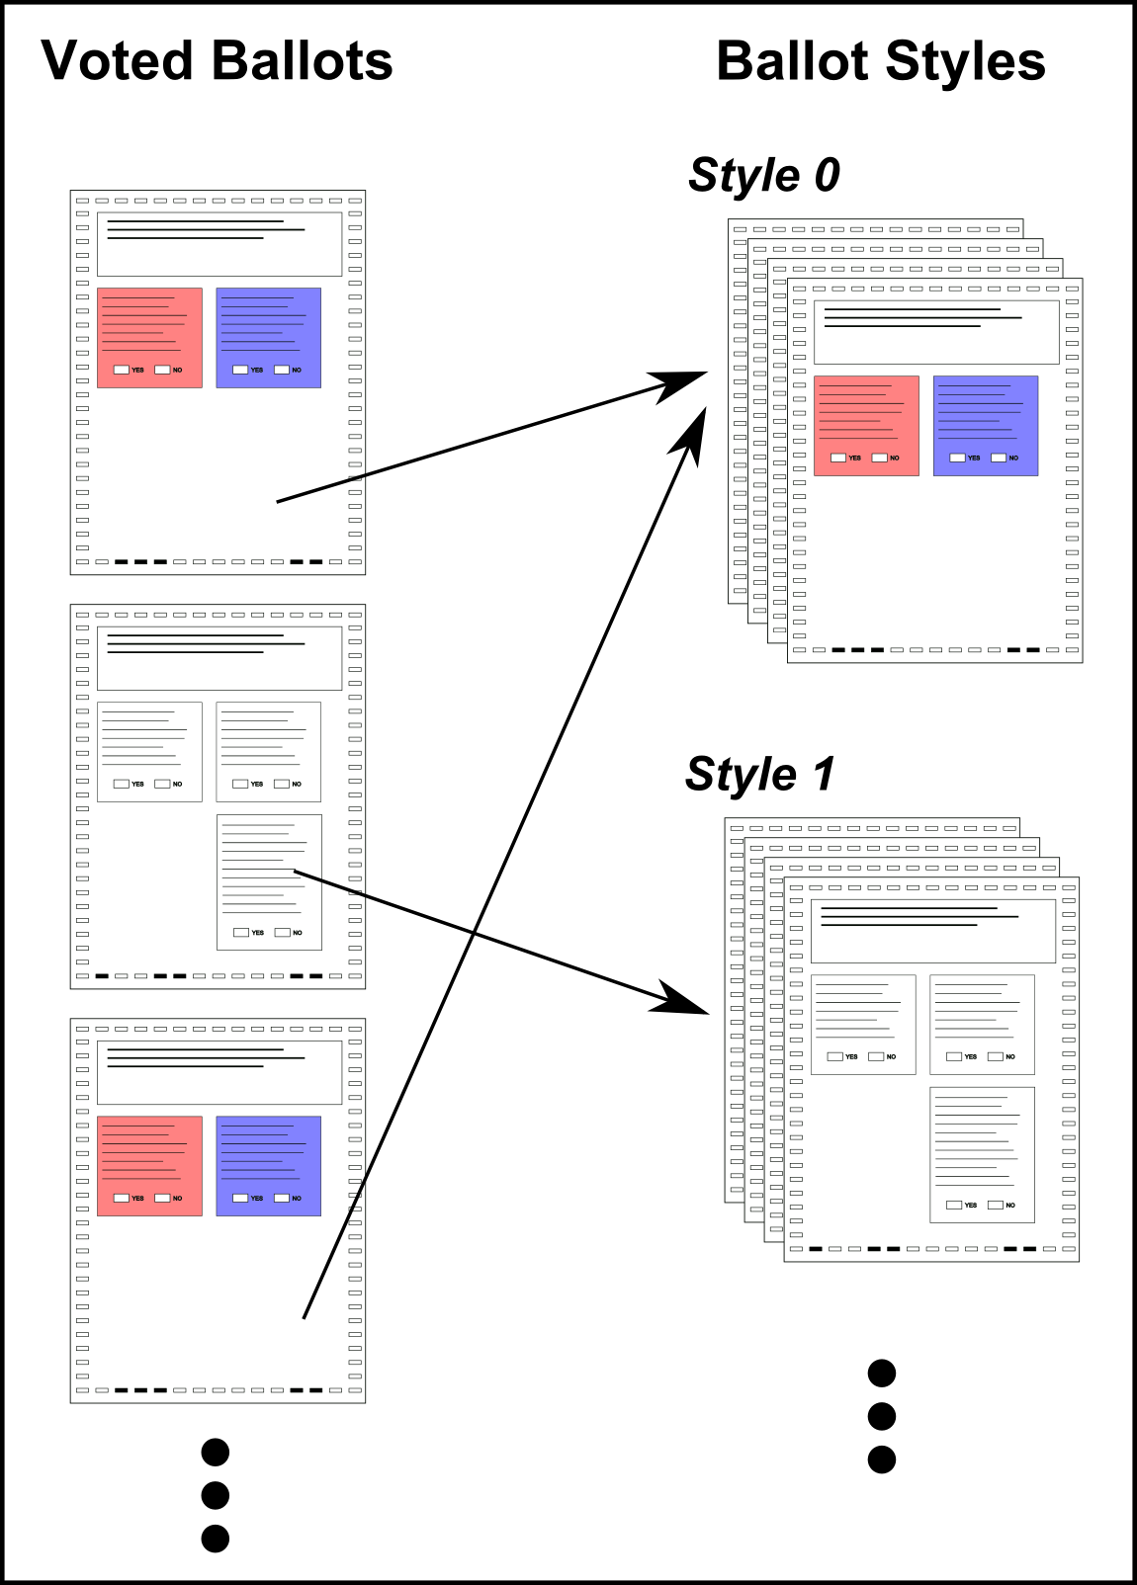
Ballot Grouping (2/6)
Notes:
- Makes annotation easier (only annotate one ballot from each group)
- Number of ballot styles << number of voted ballots

Slide 29
Ballot Grouping (2/6)
~124,000 Ballots
~200 Styles
Notes:
(Numbers from Leon County, Florida, 2011 Presidential Primaries)

Slide 30
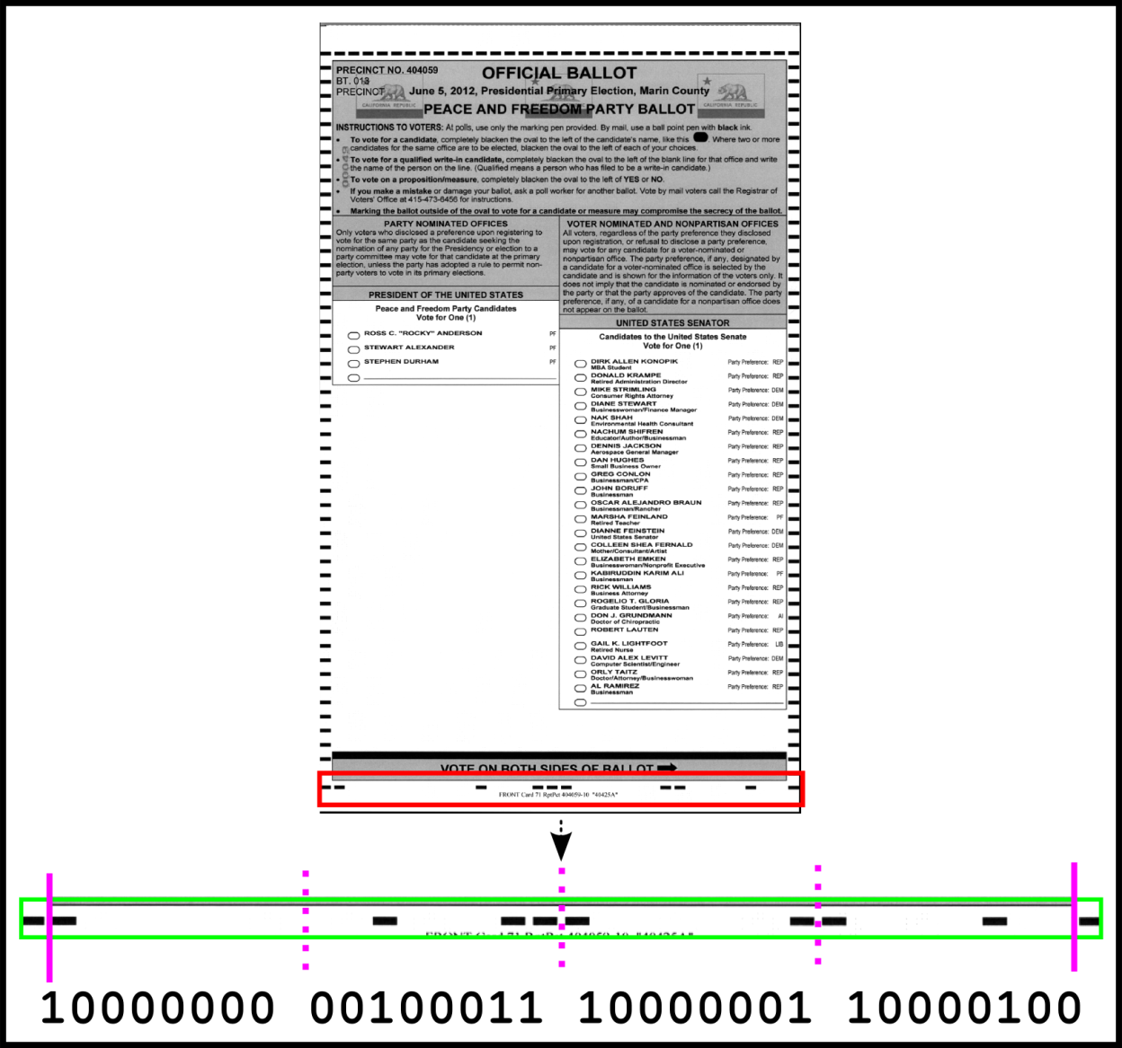
Ballot Grouping (2/6)

Slide 31
Ballot Grouping (2/6)

Slide 32
Ballot Grouping (2/6)
Implemented vendor-specific barcode decoders
Diebold
ES&S
Hart
Sequoia

Slide 33
Layout Annotation (3/6)
Goal
Specify location of contests and voting targets
Perform data entry of contest text
Only need to annotate one ballot from each style

Slide 34


Layout Annotation (3/6)
How to find voting targets automatically?

Slide 35
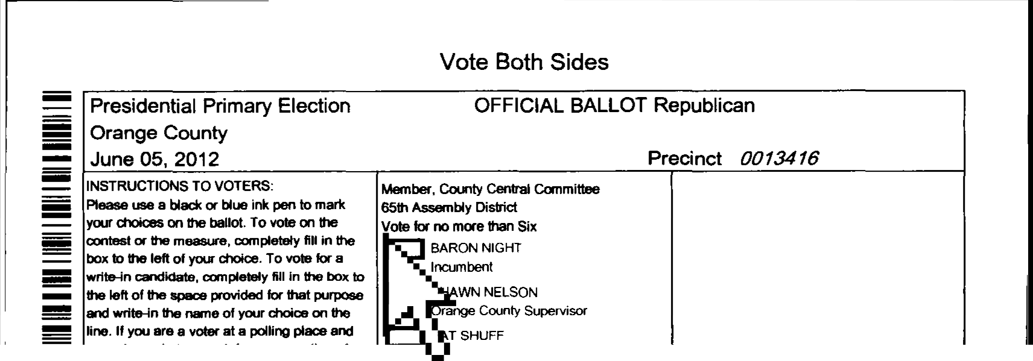
Layout Annotation (3/6)
1.) User selects empty voting target

Slide 36
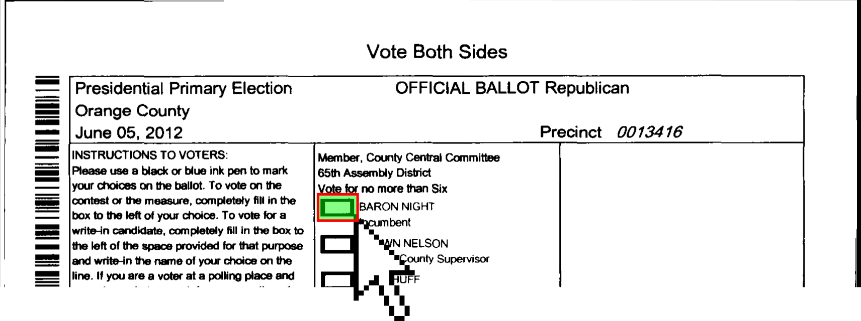
Layout Annotation (3/6)
1.) User selects empty voting target

Slide 37

Layout Annotation (3/6)
Search for empty voting target on ballots
Template Matching
Grid-search
Search for this:

Slide 38
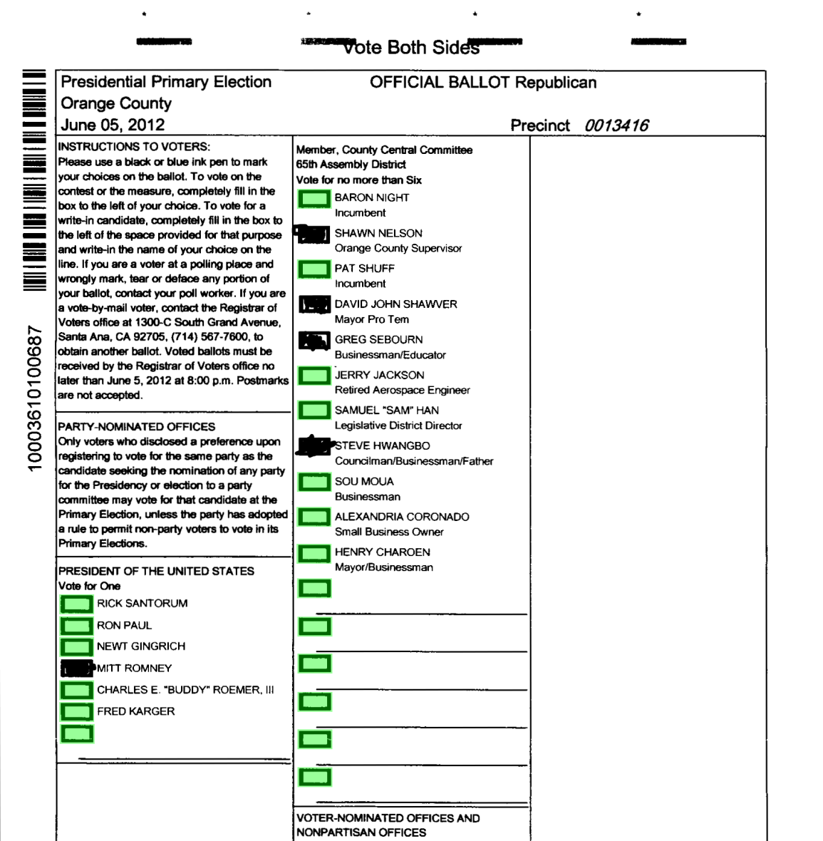
Layout Annotation (3/6)
Verify Matches

Slide 39
Layout Annotation (3/6)
Problem: Voter marks interfere with template matching

Slide 40
Layout Annotation (3/6)
Problem: Voter marks interfere with template matching
Idea: Voters vote differently. Can find missing targets on other ballots with the same style

Slide 41
Layout Annotation (3/6)
Ballot A
Idea: Voters vote differently. Can find missing targets on other ballots with the same style

Slide 42
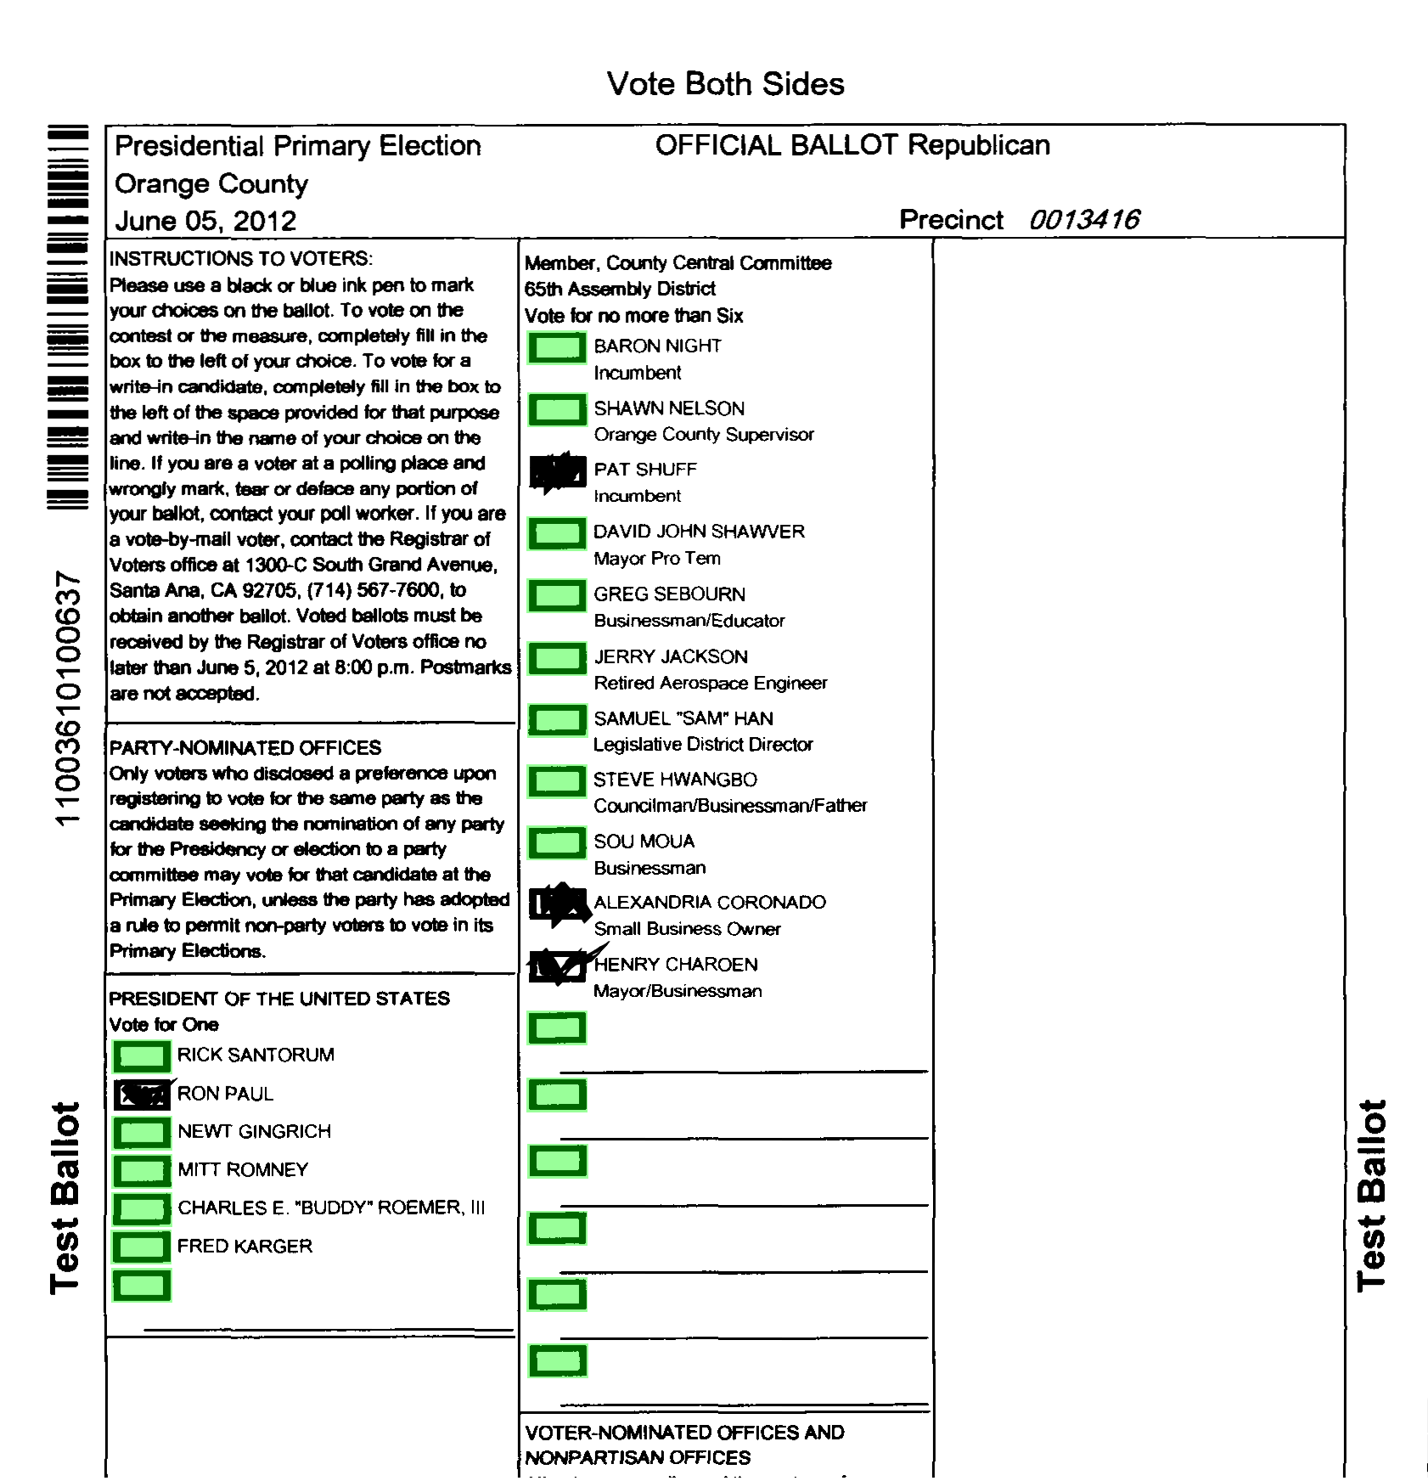
Layout Annotation (3/6)
Ballot B
Idea: Voters vote differently. Can find missing targets on other ballots with the same style

Slide 43
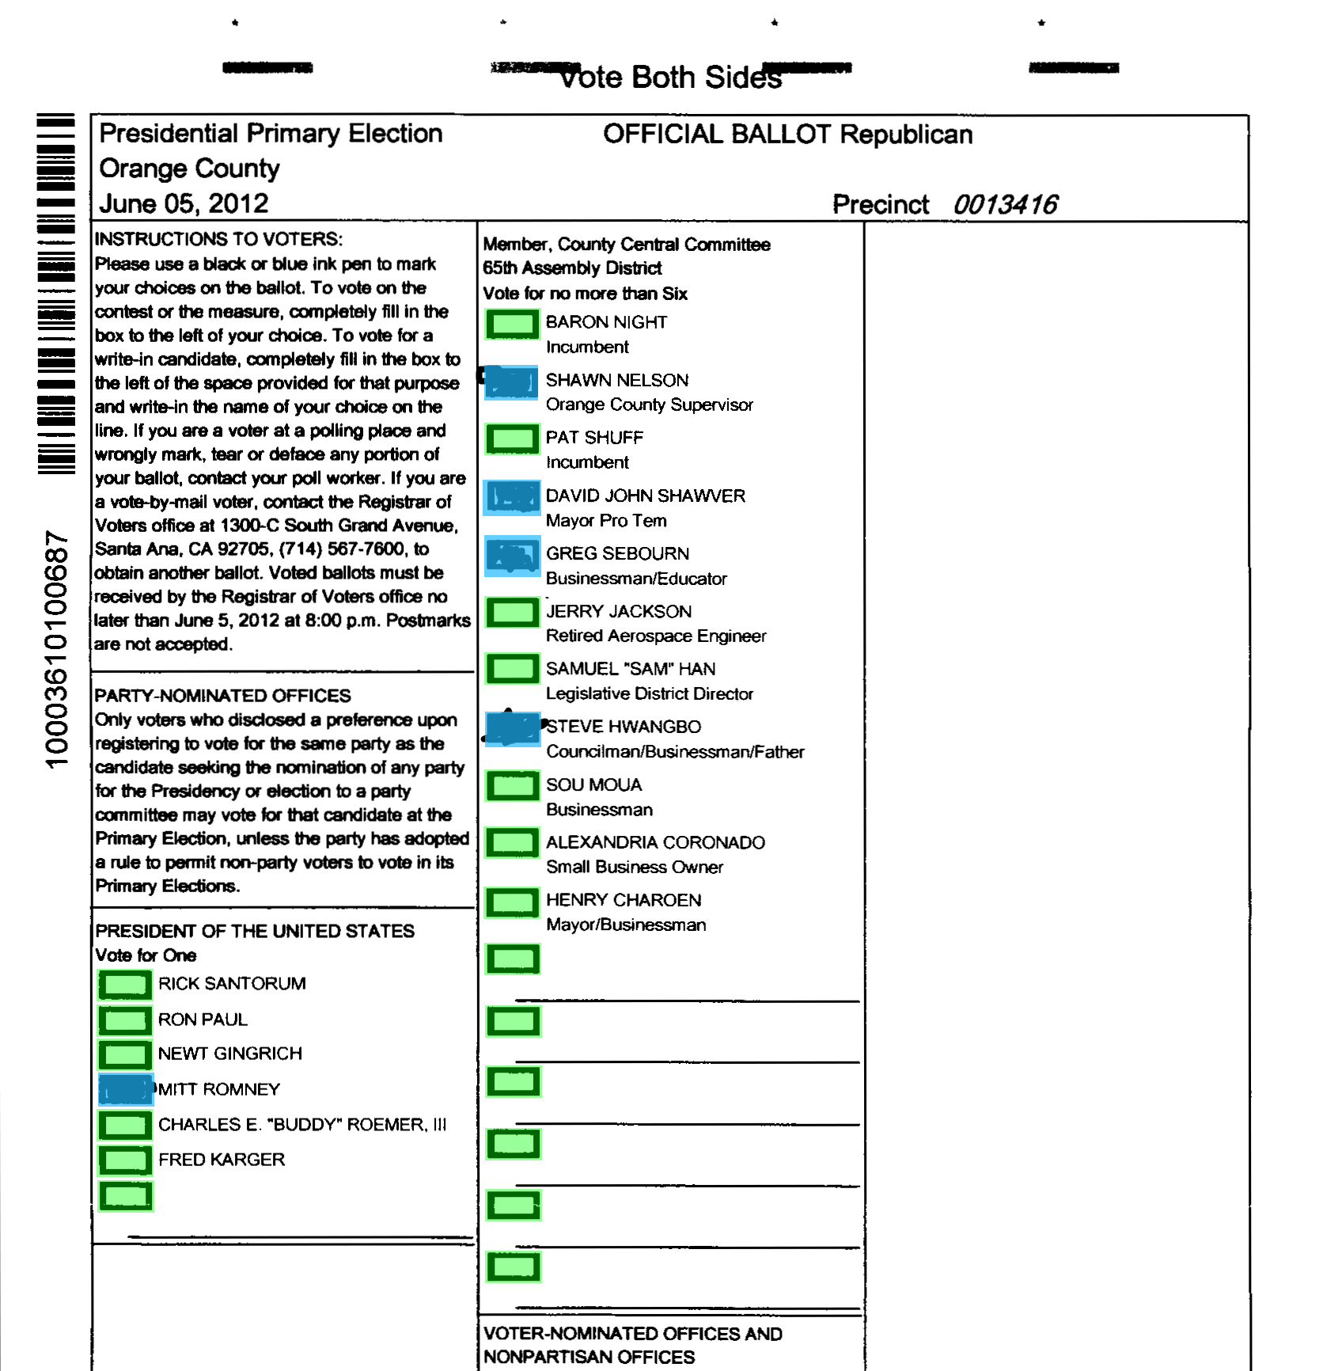
Layout Annotation (3/6)
Union of detections from A + B
Idea: Voters vote differently. Can find missing targets on other ballots with the same style

Slide 44
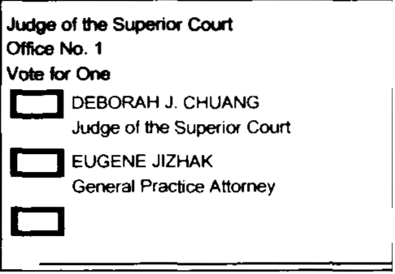
Layout Annotation (3.5/6)
Contest text data entry
Contest title, candidate names
Judge of the Superior Court (Office No. 1)
Deborah J. Chuang
Eugene Jizhak

Slide 45
Layout Annotation (3.5/6)
Can’t rely completely on OCR
Manually labeling each contest takes forever
Number of distinct contests is small
A few hundred at most
Contests are duplicated on many ballot styles
“President of the US”
Notes:
# of distinct contests: ~30-100 (for instance, Leon had 36 contests. Orange has >38)

Slide 46
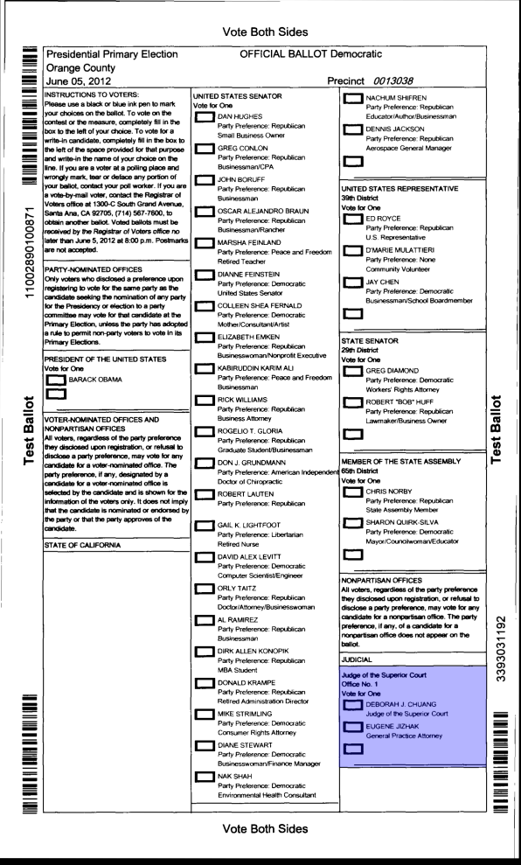
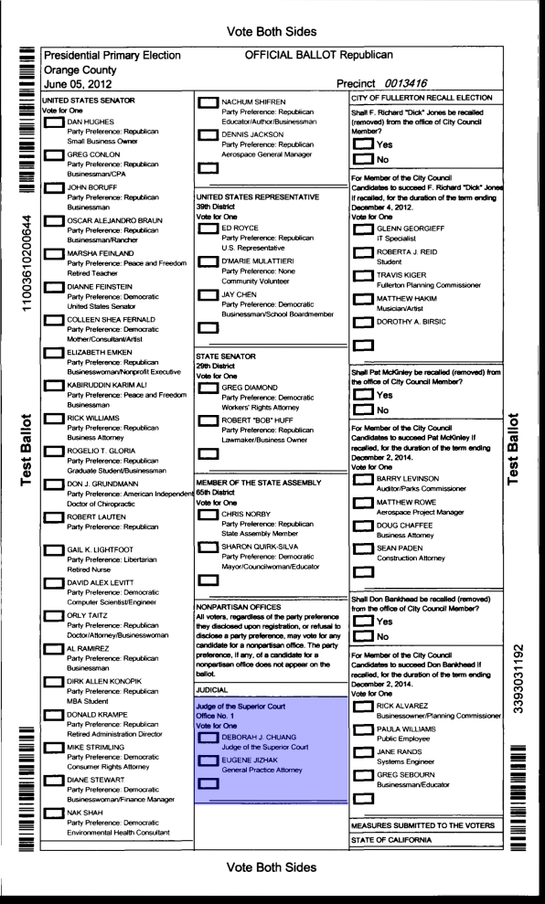
Layout Annotation (3.5/6)
Should only have to label this contest once!

Slide 47
Layout Annotation (3.5/6)
Want to detect contest duplicates
Simple idea: compare contest images
Pixel-difference (L2 norm)

Slide 48
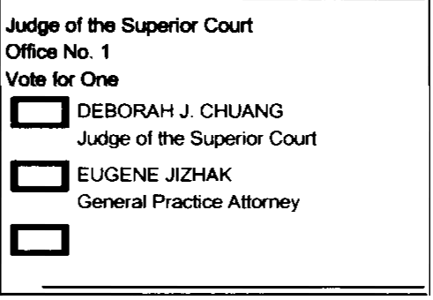
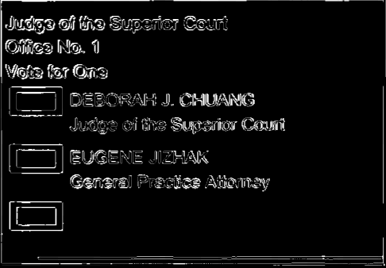
Layout Annotation (3.5/6)
-
Diff = 0.058
MATCH

Slide 49
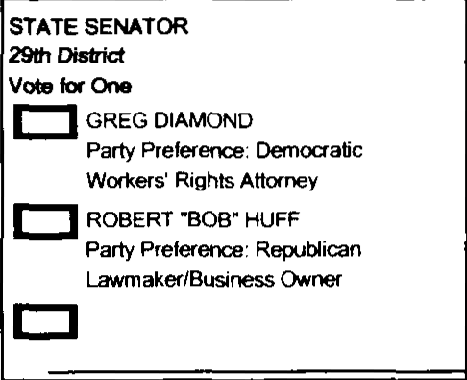
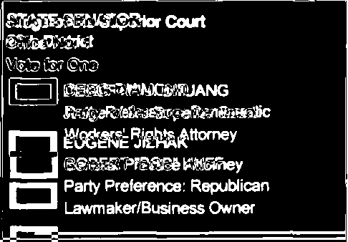
Layout Annotation (3.5/6)
-
Diff = 0.175
NOT MATCH

Slide 50
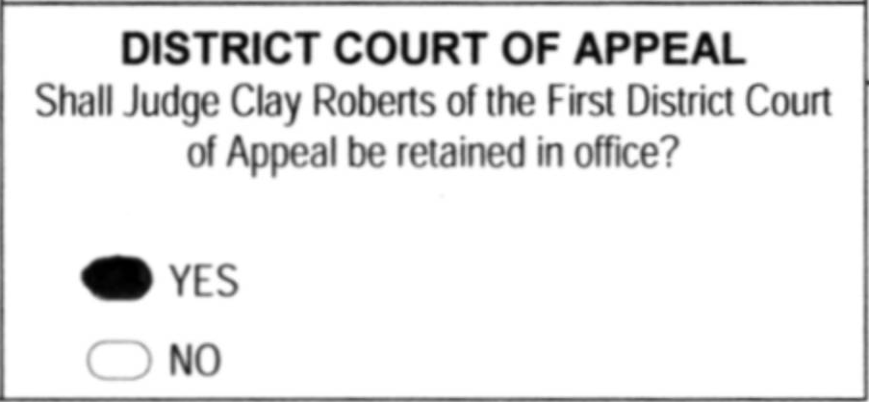
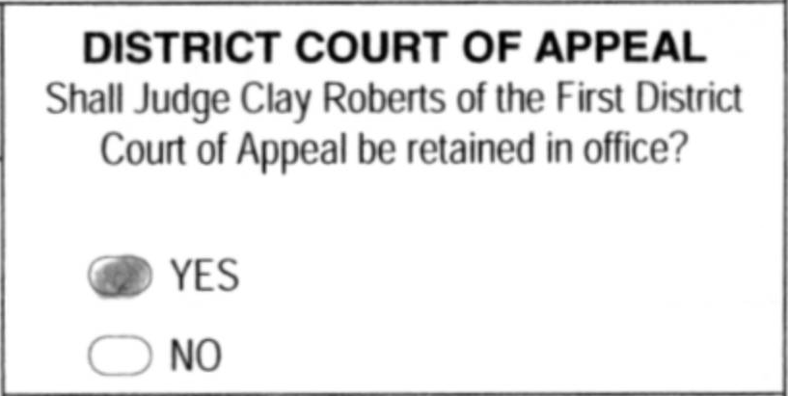
Layout Annotation (3.5/6)
Problem: contest visual appearance varies
Word spacing, line wrapping, candidate re-ordering
Different Line Wrap

Slide 51


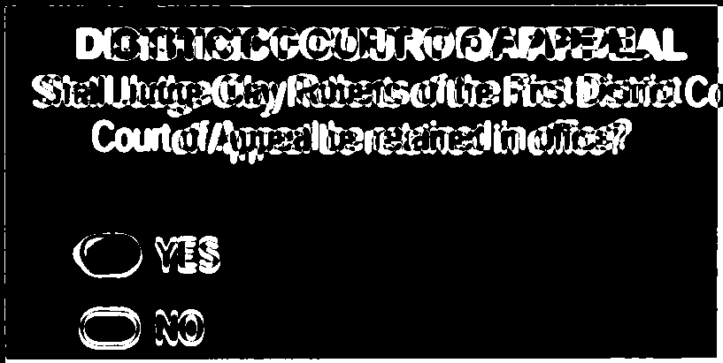
Layout Annotation (3.5/6)
-
Diff = 0.146
NOT MATCH

Slide 52
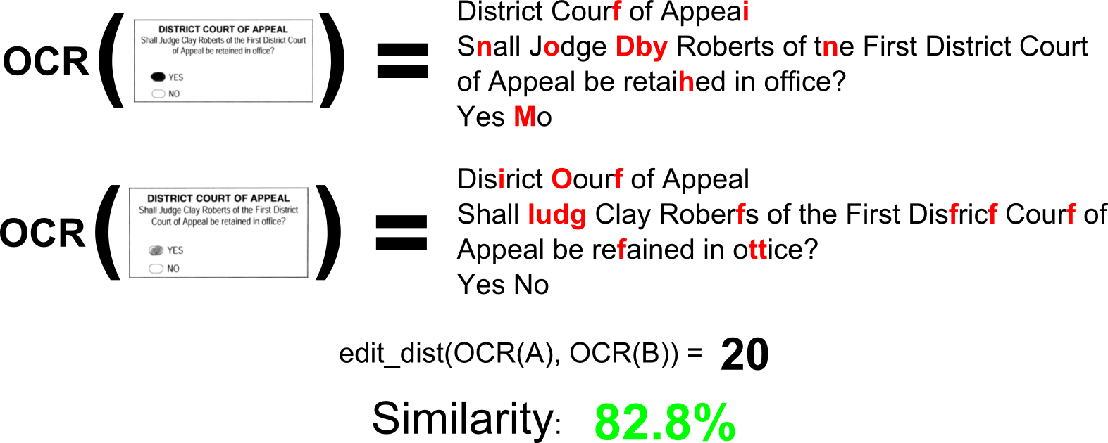
Layout Annotation (3.5/6)
Our approach: utilize OCR + edit-distance

Slide 53
Layout Annotation (3.5/6)
Our approach: utilize OCR + edit-distance

Slide 54
Layout Annotation (3.5/6)
Our approach: utilize OCR + edit-distance

Slide 55
Layout Annotation (3.5/6)
Our approach: utilize OCR + edit-distance
Match!

Slide 56













Ballot Interpretation (4/6)
Goal
Determine if voting targets are “filled” or “empty”
Filled
Empty

Slide 57
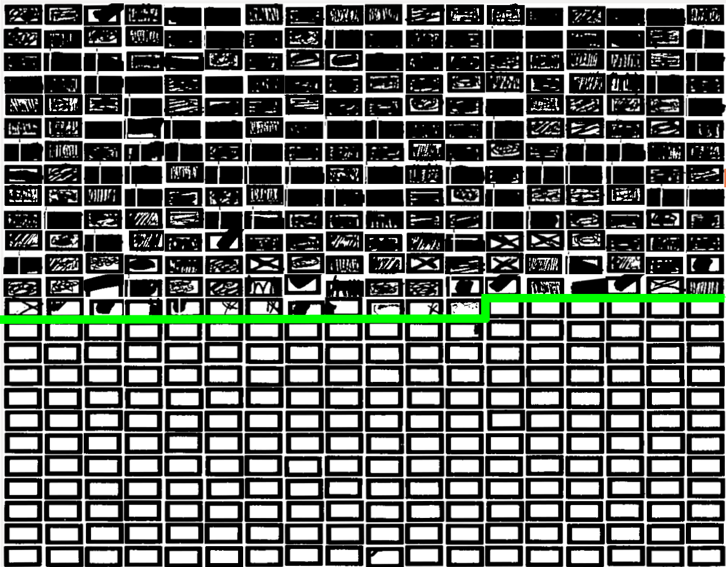
Ballot Interpretation (4/6)
Separating Line
Sorted by Average Pixel Intensity

Slide 58

Ballot Interpretation (4/6)

Slide 59
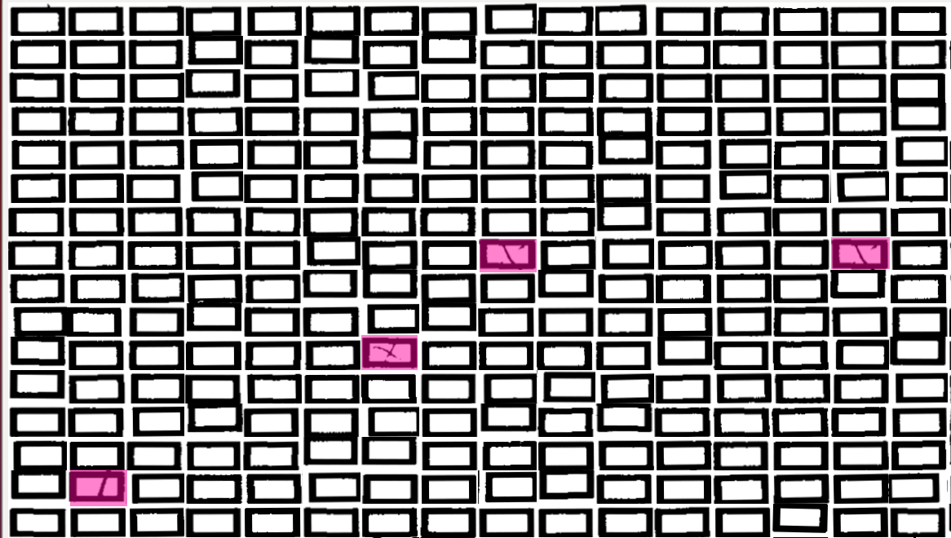
Ballot Interpretation (4/6)

Slide 60
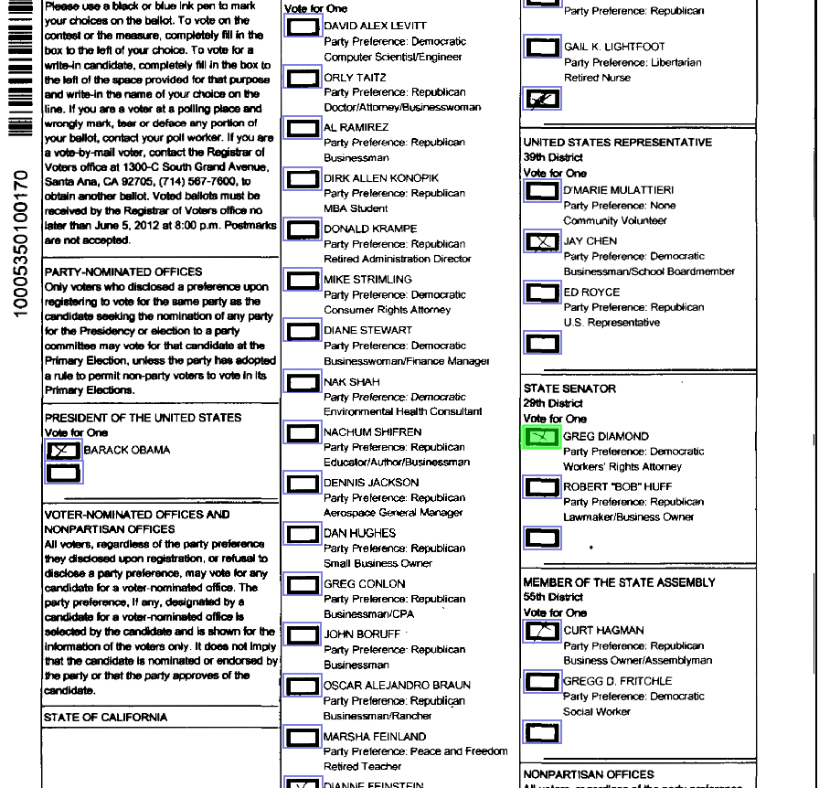
Ballot Interpretation (4/6)

Slide 61
Ballot Interpretation (4/6)
Filled
Empty

Slide 62
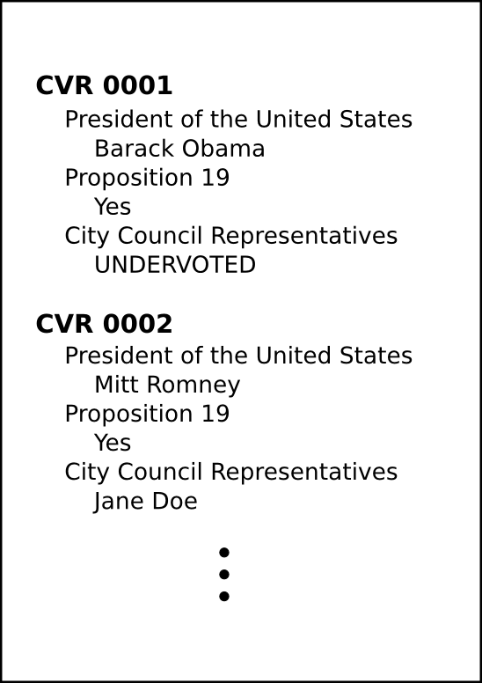
Generate CVRs (5/6)
Output CVRs

Slide 63
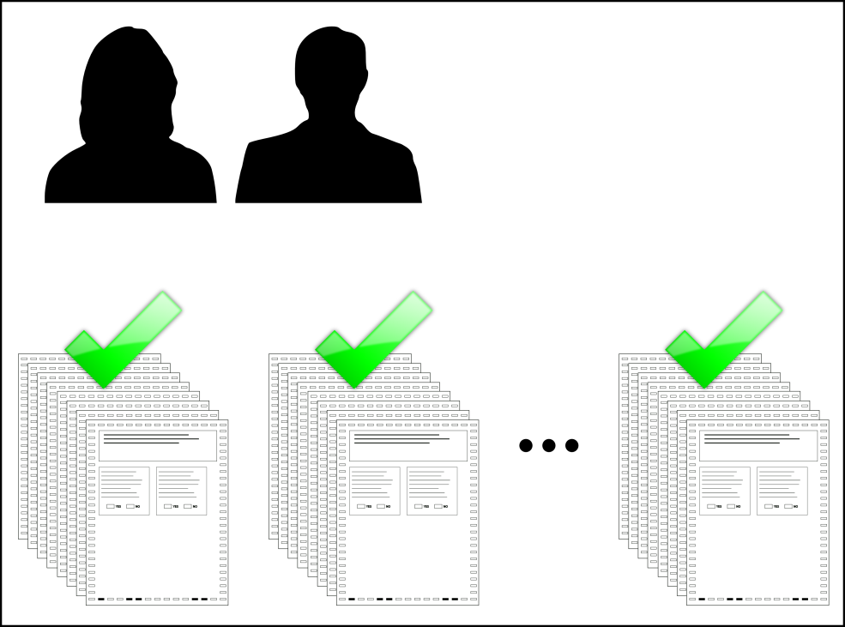
Perform Audit (6/6)
Finally, perform the audit!
Done!

Slide 64
Election Experiences
OpenCount has been used to support risk limiting pilot audits in several California counties
Alameda, Madera, Merced, Napa, San Luis Obispo, Stanislaus, Ventura
OpenCount’s results matched all examined paper ballots perfectly
Notes:
We have used OpenCount to process a total of 7 election datasets.
The election size and complexity ranged from small and simple to large and complex.

Slide 65
Election Experiences (cont.)
County | # Ballots | # Ballot Styles | Total Time (2013)
Stanislaus | 3,151 | 1 | 7m 18s
Merced | 7,120 | 1 | 12m 31s
Ventura | 17,301 | 1 | 23m 6s
Alameda | 1,374 | 8 | 22m 1s
San Luis Obispo | 10,689 | 27 | 30m 35s
Madera | 3,757 | 1 | 6m 38s
Napa | 6,809 | 11 | 1h 56m 9s
Yolo | 35,532 | 623 | 3h 36m
Notes:
Absolute time is still reasonable

Slide 66
Election Experiences (cont.)
County | # Ballots | # Ballot Styles | Total Time (2013) | Speedup (2012 / 2013)
Stanislaus | 3,151 | 1 | 7m 18s | 2.40x
Merced | 7,120 | 1 | 12m 31s | 2.04x
Ventura | 17,301 | 1 | 23m 6s | 2.52x
Alameda | 1,374 | 8 | 22m 1s | 1.29x
San Luis Obispo | 10,689 | 27 | 30m 35s | 2.78x
Madera | 3,757 | 1 | 6m 38s | 1.28x
Napa | 6,809 | 11 | 1h 56m 9s | 2.78x
Yolo | 35,532 | 623 | 3h 36m | 16.24x
Notes:
Many of the improvements don’t play huge role for small elections

Slide 67
Election Experiences (cont.)
County | # Ballots | # Ballot Styles | Total Time (2013) | Speedup (2012 / 2013)
Stanislaus | 3,151 | 1 | 7m 18s | 2.40x
Merced | 7,120 | 1 | 12m 31s | 2.04x
Ventura | 17,301 | 1 | 23m 6s | 2.52x
Alameda | 1,374 | 8 | 22m 1s | 1.29x
San Luis Obispo | 10,689 | 27 | 30m 35s | 2.78x
Madera | 3,757 | 1 | 6m 38s | 1.28x
Napa | 6,809 | 11 | 1h 56m 9s | 2.78x
Yolo | 35,532 | 623 | 3h 36m | 16.24x

Slide 68
Election Experiences (cont.)
County | # Ballots | # Ballot Styles | Total Time (2013) | Human Time
Marin | 29,121 | 398 | 11h 53m | 5h 45m
Santa Cruz | 34,004 | 136 | 18h 50m | 5h 27m
Leon | 124,200 | 216 | 14h 2s | 1h 53m
Orange | 294,402 | 1,839 | 3d 22h 39s | 1d 8h 25m
Previous version (2012) could not process elections of this size and complexity.
Progress!
Notes:
We can now handle reasonably large elections.
But maybe not the largest (LA County, 1.5 million ballots)

Slide 69
Conclusion
Improvements to the OpenCount system
Don’t have to collect blank ballots
Reduce operator effort significantly
OpenCount is ready for election officials to use
Used in ballot-level risk-limiting audits
Audits made possible by OpenCount

